Slide 1
Competition

Slide 2
What is plant competition?
Grime (1977): “the tendency of neighboring plants to utilize the same quantum of light, ion of a mineral nutrient, molecule of water, or volume of space”

Slide 3
What is plant competition?
Grime (1977): “the tendency of neighboring plants to utilize the same quantum of light, ion of a mineral nutrient, molecule of water, or volume of space”
Why neighboring?

Slide 4
What is plant competition?
Grime (1977): “the tendency of neighboring plants to utilize the same quantum of light, ion of a mineral nutrient, molecule of water, or volume of space”
Not all abiotic and biotic drivers of plant fitness
Why these specifically?

Slide 5
What is plant competition?
Grime (1977): “the tendency of neighboring plants to utilize the same quantum of light, ion of a mineral nutrient, molecule of water, or volume of space”
”allows competition to be defined in relation to its mechanism rather than its effects, and the risk is avoided of confusion with mechanism operating through the the direct impact of the physiochemical environment or through biotic effects such as selective predation”

Slide 6
What is plant competition?
Grime (1977): “the tendency of neighboring plants to utilize the same quantum of light, ion of a mineral nutrient, molecule of water, or volume of space”
”allows competition to be defined in relation to its mechanism rather than its effects, and the risk is avoided of confusion with mechanism operating through the the direct impact of the physiochemical environment or through biotic effects such as selective predation”

Slide 7
What is plant competition?
Grime (1977): “the tendency of neighboring plants to utilize the same quantum of light, ion of a mineral nutrient, molecule of water, or volume of space”
”allows competition to be defined in relation to its mechanism rather than its effects, and the risk is avoided of confusion with mechanism operating through the the direct impact of the physiochemical environment or through biotic effects such as selective predation”

Slide 8
What is plant competition?
Grime (1977): “the tendency of neighboring plants to utilize the same quantum of light, ion of a mineral nutrient, molecule of water, or volume of space”
”allows competition to be defined in relation to its mechanism rather than its effects, and the risk is avoided of confusion with mechanism operating through the the direct impact of the physiochemical environment or through biotic effects such as selective predation”

Slide 9
Plant perception of competition

Slide 10
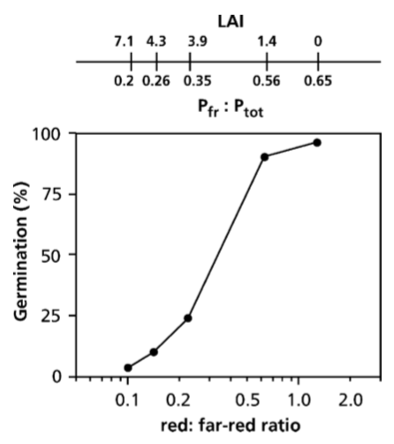
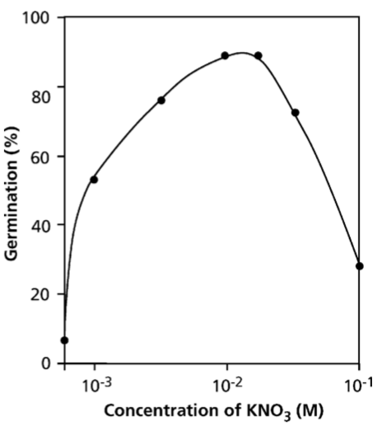
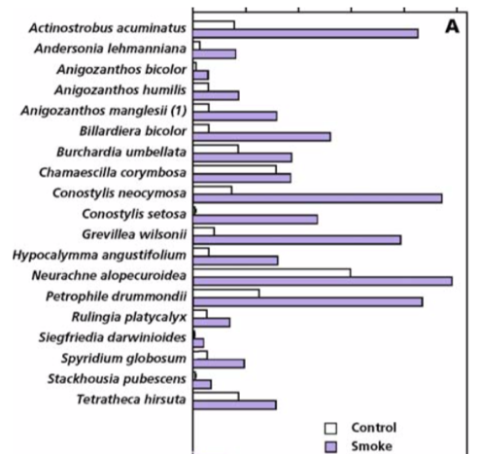
Perception by seeds: recap
Germination

Slide 11
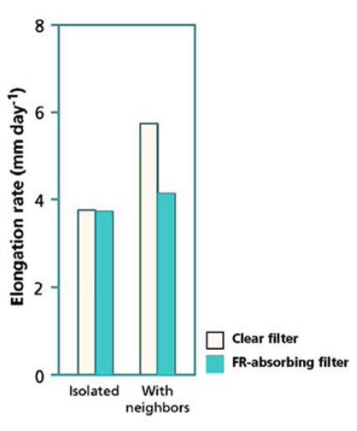
Seedlings also perceive light from the canopy
Stem elongation occurs when neighbors are present and reducing the ratio of red light to far red light. Plants are sensing they are under a canopy and elongating stems to access the limited light.

Slide 12
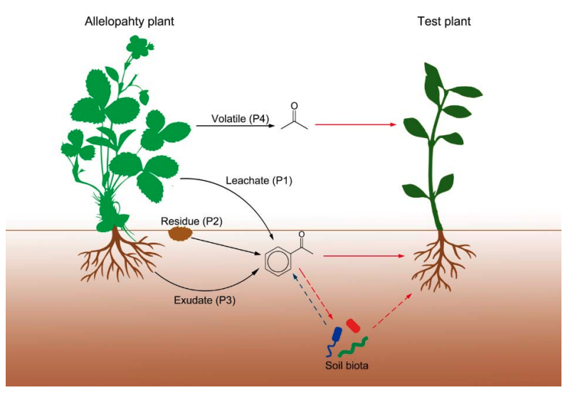
Allelopathy: plant chemical sensing
Zhang et al. (2020)

Slide 13
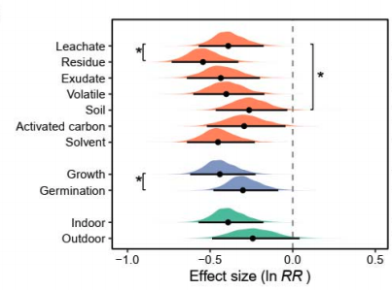
Allelopathy tends to have negative impacts on plants
Zhang et al. (2020)

Slide 14
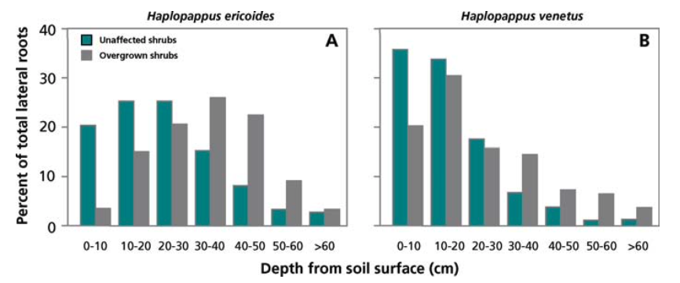
Allelopathy can stimulate plastic responses
Increased belowground competition

Slide 15
Allelopathy and invasion example

Slide 16
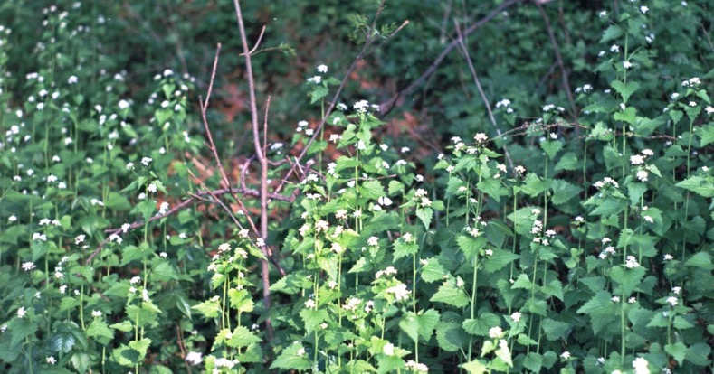
Allelopathy and invasion
Gold: invader present
Blue: invader absent
Garlic mustard is an allelopathic invader that alters microbial communities …
Bialic-Murphy et al. (2020)

Slide 17
Allelopathy and invasion
Gold: invader present
Blue: invader absent
…which influences native plant traits …
Bialic-Murphy et al. (2020)

Slide 18
Allelopathy and invasion
… and reduces native plant growth …
Bialic-Murphy et al. (2019)

Slide 19
Allelopathy and invasion
… and fitness!
Bialic-Murphy et al. (2019)

Slide 20
Resource competition and traits

Slide 21
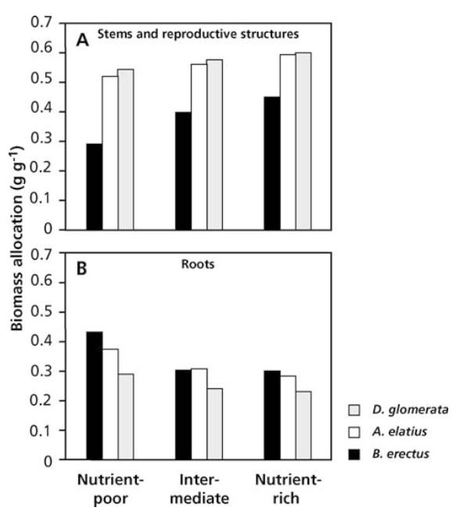
Traits: nutrient competition
Nutrient stress promotes root competition,
increasing root biomass allocation

Slide 22
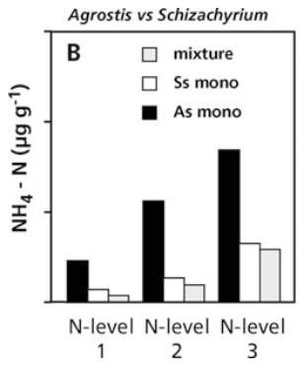
Traits: nutrient competition
Nutrient stress promotes root competition,
favoring low growth rate species
Presence of slow growing Schizachyrium (Ss) reduces nutrient availability (R* hypothesis), hampering growth of fast growing Agrostis (As)

Slide 23
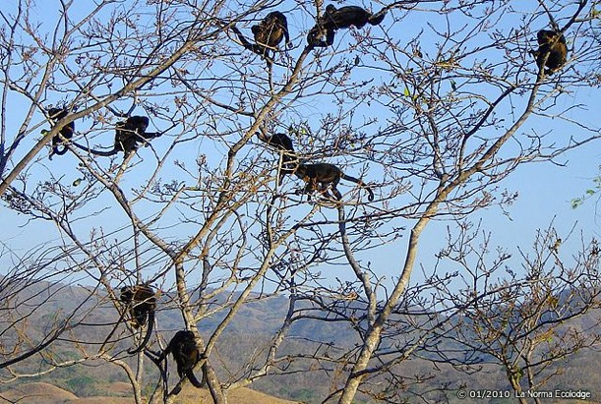
Traits: water competition
Toleration of soil low water potential
Similar to R* for nutrients?
Desiccation resistance
E.g., CAM and C4 photosynthesis
Desiccation avoidance
Phenology

Slide 24
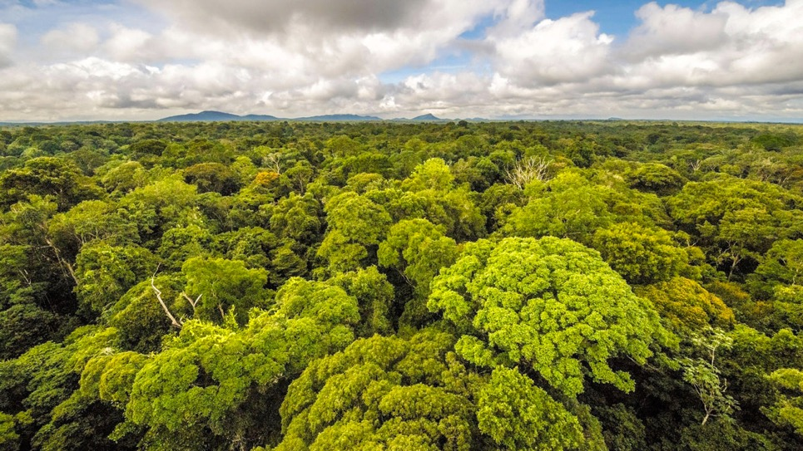
Traits: light competition
Light competition only occurs when belowground resources are plentiful

Slide 25
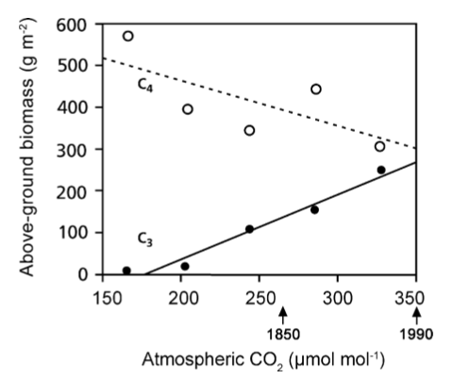
Traits: CO₂ competition

Slide 26
Traits: CO₂ competition
Are these competing according to Grime’s definition?

Slide 27
Competitive strategies

Slide 28
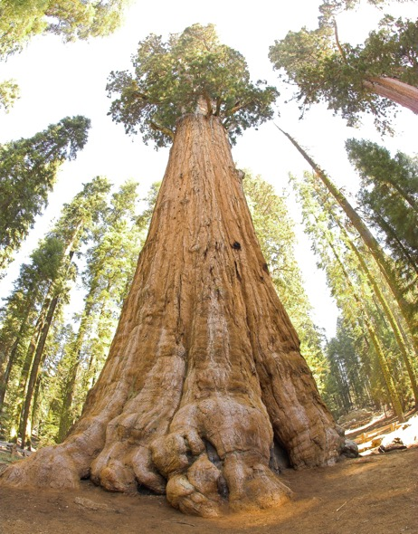
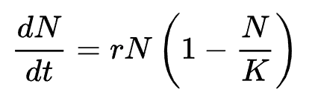
r-K continuum
N = population size
t = time
r = population growth rate
K = carrying capacity

Slide 29
r-K continuum
Where would r species dominate?
Where would K species dominate?

Slide 30
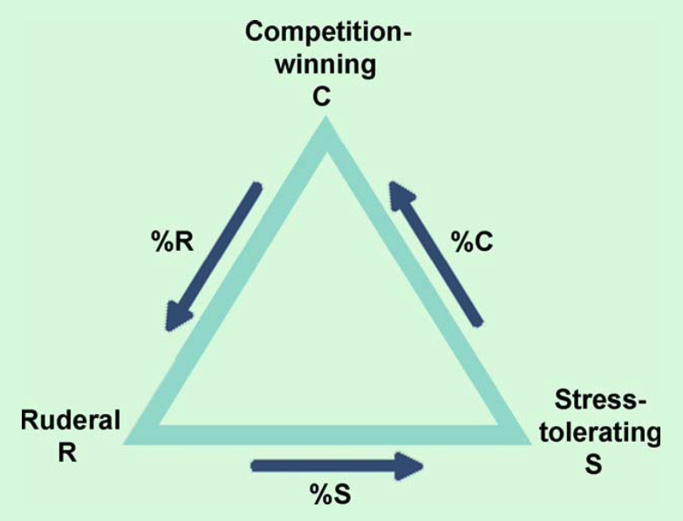
Grime’s (1977) triangle

Slide 31
Grime’s (1977) triangle
What is different from r-K?

Slide 32
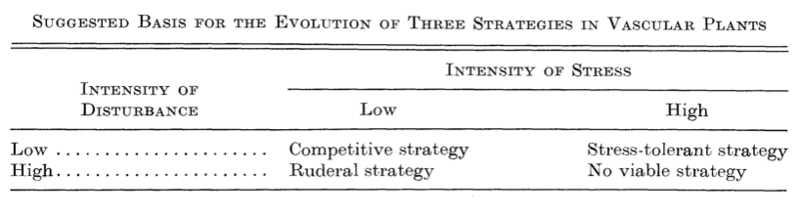
Grime’s (1977) triangle

Slide 33
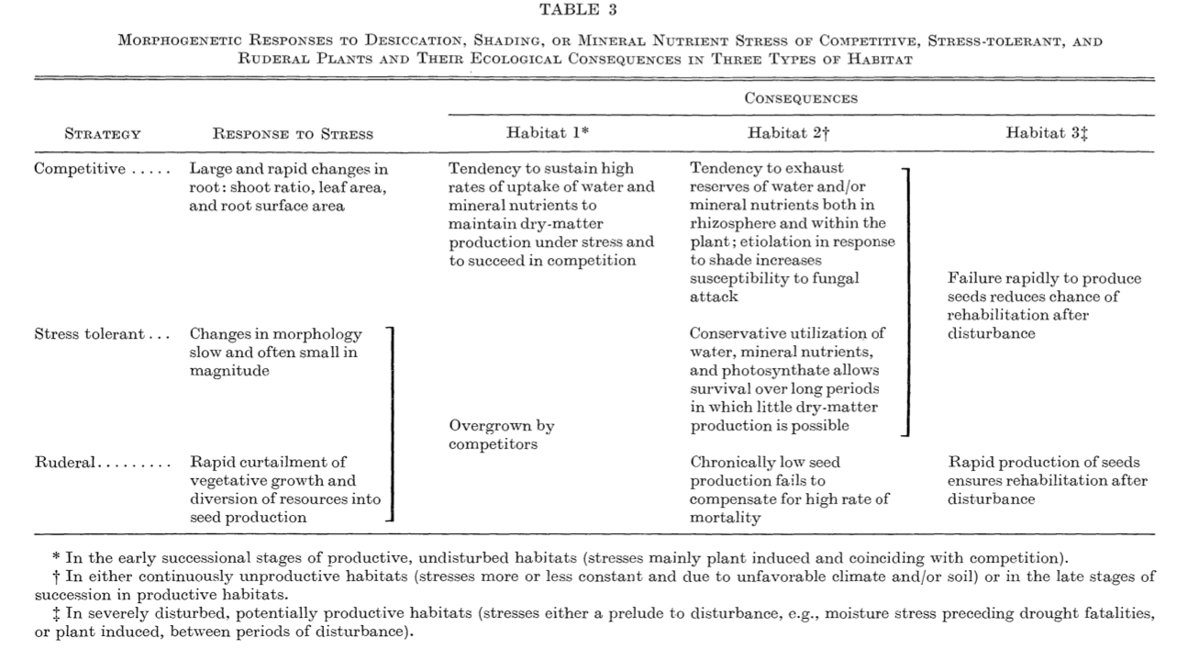

Slide 34
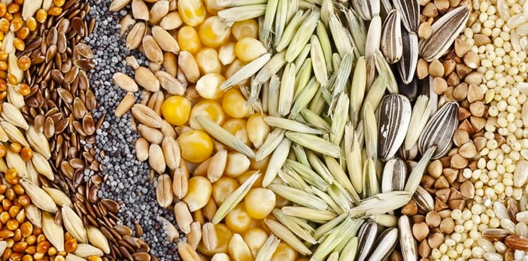
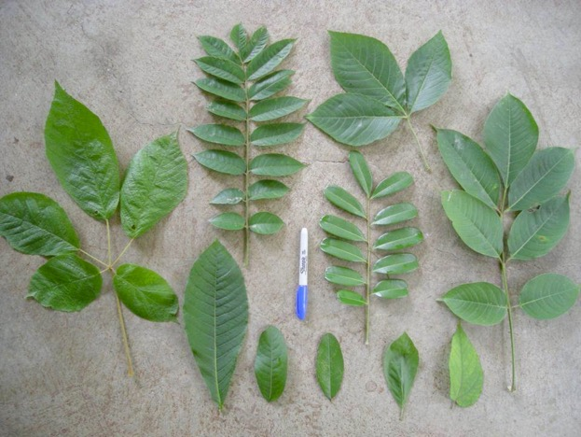
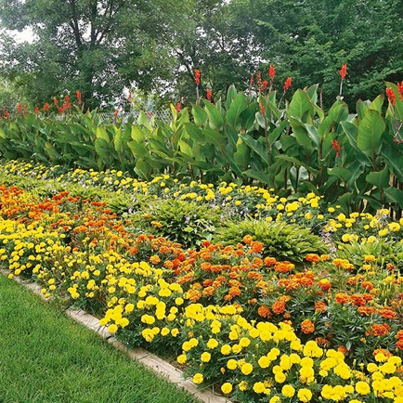
Westoby (1998) Leaf-Height-Seed theory
SLA describes the competition-stress tolerance tradeoff
Plant height and seed mass reflect aspects of coping with disturbance

Slide 35
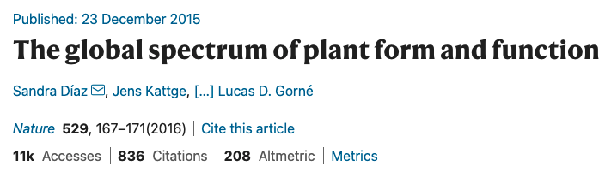
Diaz et al. (2016)

Slide 36
r-K
Diaz et al. (2016)

Slide 37
C
R
S
Diaz et al. (2016)

Slide 38
L
H
S
Diaz et al. (2016)

